Slide 1


JAYOTI VIDYAPEETH WOMEN'S UNIVERSITY ETCDWP-II-2019
ROBOT VISION: EYE FOR THE ROBOTS
Presented By:
Jv’n Priyanka Soni (JV-U/17/1245)
Jv’n Anshu Singh Parihar(JV-U/17/1156)
Jv’n Priyanka Kumawat(JV-U/17/1282)
B.tech (C.S.) 2nd year Student

Slide 2
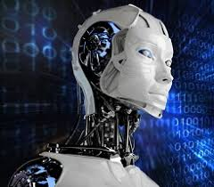
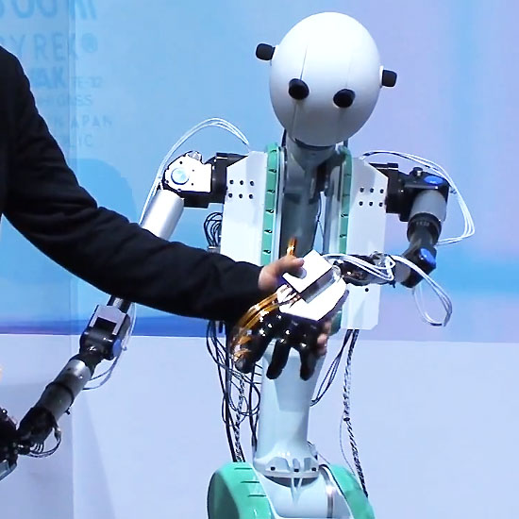
Robots
A Robot is a mechanical or virtual agent, usually a electromechanical machine that is guided by a computer program or electronic circuitry.

Slide 3

Vision
Robot Vision involves using a combination of camera hardware and computer algorithms to allow robots to process visual data from the world.
Without Robot Vision, your robot is essentially blind. This is not a problem for many robotic tasks, but for some applications Robot Vision is useful or even essential.

Slide 4
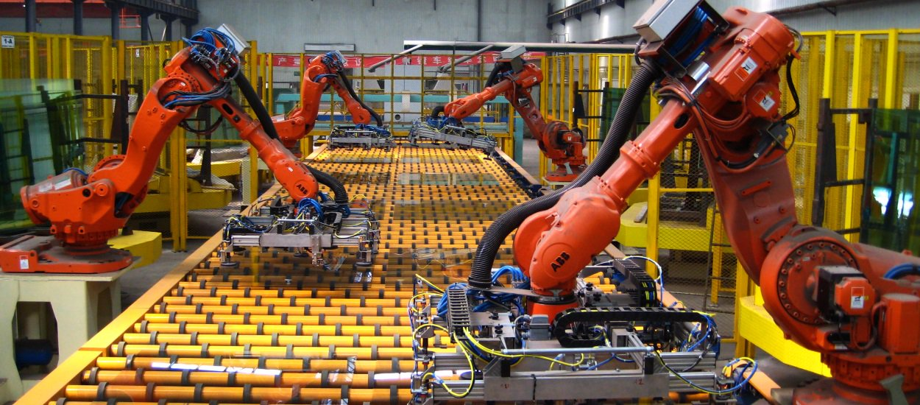
How does Vision system Works
A vision system in a robot identifies an object by forming an electronic image using a bunch of pixels already stored in the memory of the robot’s controlling unit. Each pixel has a binary number allotted to it. Each of these binary numbers represents a particular wavelength and intensity in the light spectrum. An electronic image is formed in the controlling unit of the robot by assembling various binary numbers according to the amount of light.

Slide 5

Developing Challenges
Distinguishing backgrounds and objects
Identifying moving objects
Identifying partially covered objects
Recognizing changing shapes or articulation
Understanding the position and orientation of objects

Slide 6

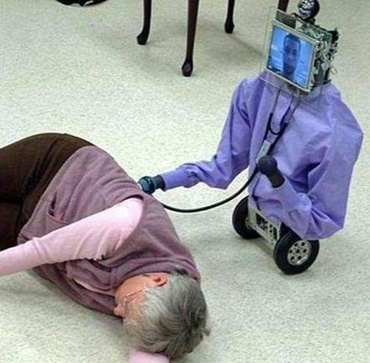
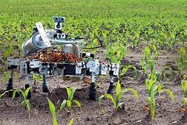
Advantages
Cost Effectiveness
Improved Quality Assurance
Increased Productivity
Work In Hazardous Environments

Slide 7
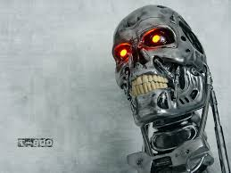
Disadvantages
Potential Job Losses
Hiring Skilled Staff
Emotion Less
Can’t be Trusted
Initial Investment Costs

Slide 8
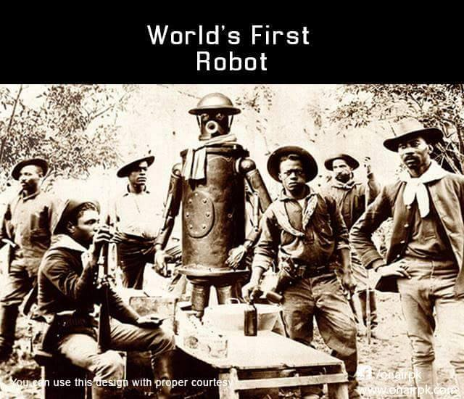
Conclusion
We assume that Robots are quicker, progressively exact, eager and uncomplaining. Either on the off chance that we understand it or not, robots assume a key job in making our, day by day lives simpler and better. From large scale manufacturing in industry, to front line exactness inside the medicinal field, robots are these days able to do massively more than their previous predecessors.
By including vision system enables a robot to see and identify various objects . It helps with these functions by using various electronic devices and hardware systems.

Slide 9


